Slide 1

Service learning course design strategies
Optimizing Instructional Practice Through Meaningful Community Alliances
Dr. Julie Turner, Lindenwood University

Slide 2
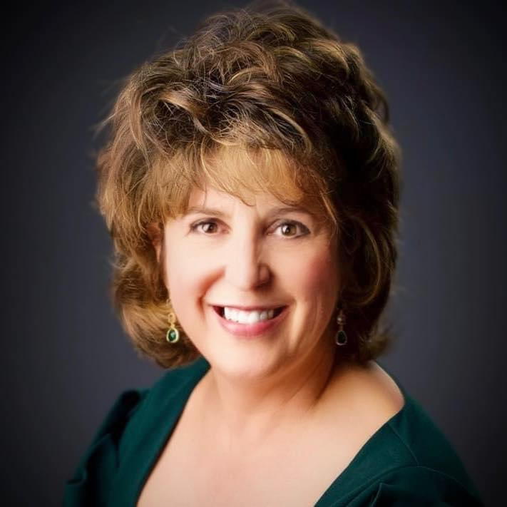
Dr. Julie Turner
Professor and Department Chair, Nonprofit Administration & Entrepreneurship
Lindenwood University
St. Charles, Missouri
Faculty Fellow, Service Learning (2019)
Degree Offerings:
Undergraduate Minor in NPA
MA in NPA (online and on-ground)
Executive Certificate in NPA

Slide 3

Workshop Objectives:
Learn how to develop a course syllabus utilizing service learning;
Structure meaningful service learning activities and outcomes; and
Articulate expectations with community partners and students.

Slide 4

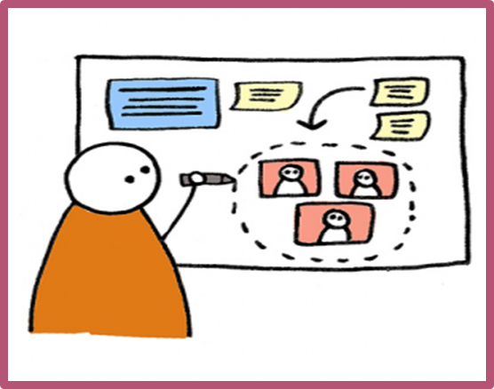
Assumptions
Have already determined that service learning is a good fit for your program and have institutional buy-in;
There is an understood definition of what service learning is; and
“Service-learning is a credit-bearing academic experience describing a unique and specialized course design strategy that combines (a.) an academic content area, (b.) fulfilling a community identified need through a reciprocal
relationship, and (c.) intentional reflection
strategies in order to enrich the learning experience,
explore civic responsibility, and strengthen communities.”
We will not have adequate time to address topics such as how to find the right service partners or assessment methods. *
* Presenter is happy to provide suggestions through post-conference follow up – jturner@lindenwood.edu!

Slide 5
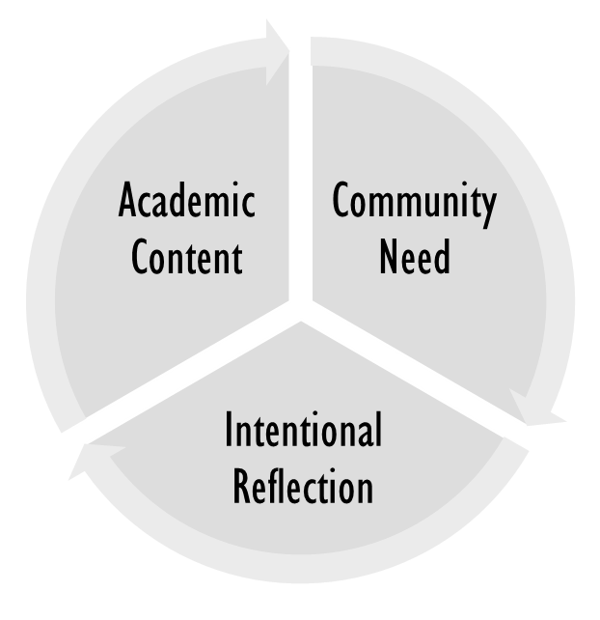
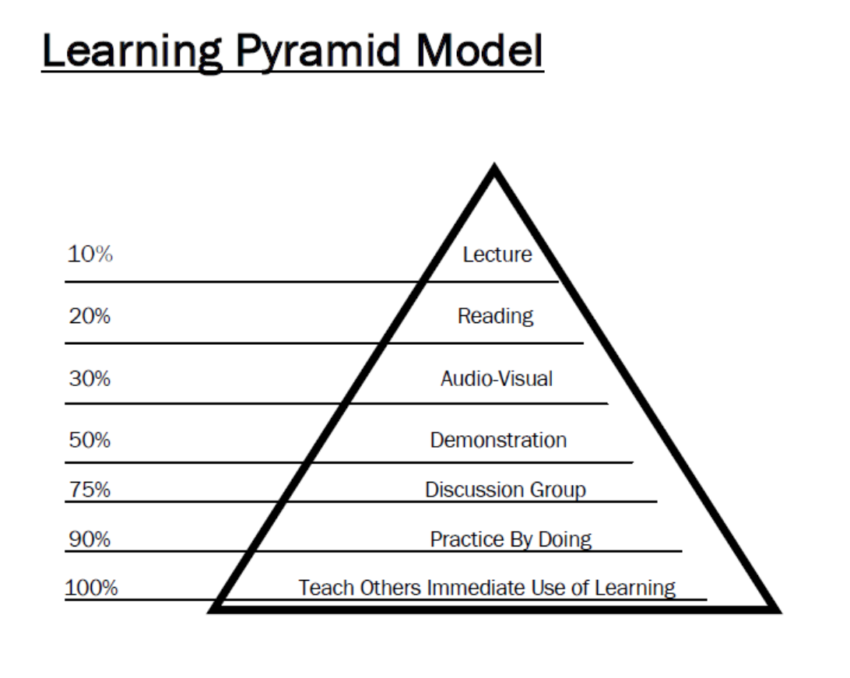
Academic Content
In a service-learning course, students acquire knowledge and develop skills based on academically rigorous content through scholarly literature, faculty lectures, independent research, group activities and a variety of other educative experiences. These knowledge and skill sets are then paired with and applied to what a community partner group (public and nonprofit agencies; civic, charitable, and governmental organizations) has identified as a need for the community it serves. Courses with a service-learning component can be offered in any academic discipline, focus on any applicable academic topic.
Fulfilling a Community Identified Need
In service-learning pedagogy, community partners are central co-instructors in the educative process. Community partners work with institutions and individual faculty members to design and implement service activities that enable students to apply newly developed knowledge and skill sets in a way that provides meaningful outcomes for the community partner and its members. Service-learning pedagogy emphasizes that community voice, knowledge, and identity play a formative role in defining what service initiatives are implemented.
Intentional Reflection
Scholarship on experiential and service-learning pedagogies consistently asserts that students cannot be expected to perform an action (such as service) and subsequently walk away with significant insights. However, when the activity is paired with reflective components, the potential that students experience significant learning is greatly increased. Reflection often manifests itself in written form, but other strategies are encouraged, as they are meaningful to the learners, such as large and small group discussion, artistic expressions like poetry, painting or drawing, as well as multimedia presentations. Regardless of modality, a service-learning experience is not complete without a reflective component.

Slide 6
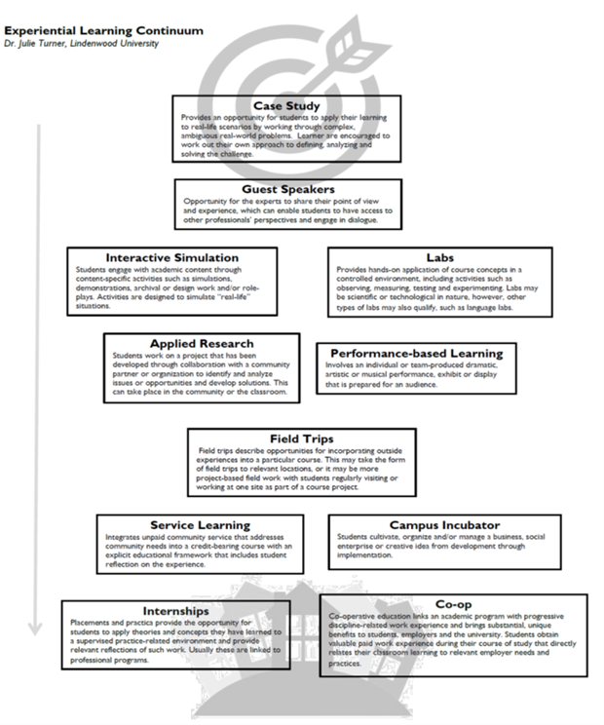
Experiential Learning comes in many forms and degrees of complexity and “externality….”
Prepared by Dr. Julie Turner, LU Faculty Fellow for Student Engagement; refer to Toolkit for hard copy

Slide 7
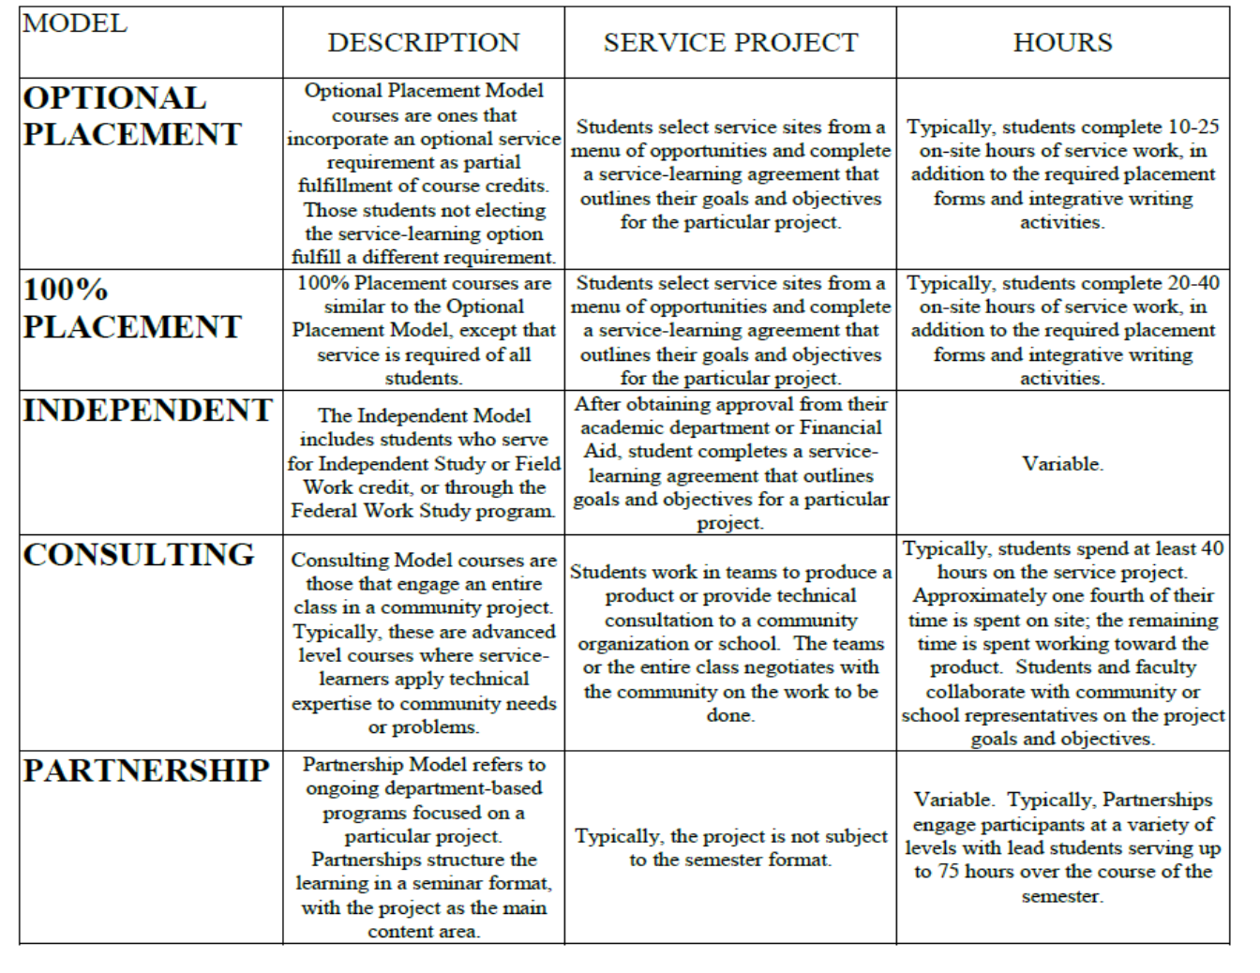
Prepared by: Community Campus Partnerships for Health. Faculty Toolkit for Service-Learning in Higher Education. Scotts Valley, CA: National Service Learning Clearinghouse

Slide 8
Step One:
Service vs. Learning objectives
Course objectives should be clearly identified as learning and service objectives and then prioritized and selected according to the interests of the partnership rather than the individual parties involved.

Slide 9

Checklist:
Review competencies for your discipline or profession and any competencies that your department or degree program has established.
Engage community partners in discussions about their expectations of student learning outcomes.
Engage faculty and students in discussions about their expectations of student learning outcomes. Establish learning and service objectives for the course.
Identify the tasks, or competencies that your students will be expected to perform following the course.
Identify what the student must learn in order to complete the task.
Determine how student learning will be measured.
Prepare for identifying your teaching methodologies.

Slide 10
How To Do It…
Write your current course learning objectives in the spaces below. Then reflect on how engagement with the community might strengthen one or more of them or enable new learning objectives. Lastly, compose assessment opportunities along with a new or revised learning objectives (if applicable) in the space below the numbered spaces.
To note, service learning typically operates best within the following “themes:”
Better Self and Social Awareness
Social Responsibility
Community and Social Justice
Multicultural Civic Engagement
Develop 21st Century Skills
Current Academic Learning Objective | Community Engagement Opportunity | Assessment Opportunity

Slide 12

Four Guiding Questions…
Engagement — Does the service component meet a public good? How will the community be consulted and how will the campus-community boundaries be negotiated?
Reflection — Is there a mechanism that encourages students to link their service experience to course content and to reflect upon why the service is important?
Reciprocity — How will your students and the community teach and learn from one another?
Public Dissemination — How will the service work be presented or returned to the public?

Slide 13

Potential student learning outcomes for service-learning courses
Refer to handout

Slide 14

Designing Community Engagement Component
Review your learning objectives. Then ask yourself:
What kind of community partner might connect to your learning objectives? Where is the partner located?
With whom would the student work?
How many “contact hours” do you think would be necessary for students to authentically engage with the community in order to achieve the course learning goals?

Slide 15

Service Site Databases
Examples (St. Louis Area)
Virtual Opportunities
United Way of Greater St. Louis Volunteer Center
Community Council of St. Charles
UMSL Community Needs Survey
Volunteer Match
Nine Network Database
St. Louis Business Journal
SLU Database
Directory of Associations
Business Associations in Missouri
Missouri Society of Association Executives
Literacy Associations
Science Promotion Organizations
Humanities
Various
Remote/virtual volunteer opportunities are on the rise, serving as particularly meaningful opportunities for online students. Here are some useful databases:
UNV Online Volunteering is a service by United Nations Volunteers that connects individual volunteers with organizations working for sustainable human development around the world.
Idealist.org is a great search tool for locating volunteer opportunities with a nonprofit focus—and you can search by location, focus area, schedule and more.
DoSomething.org allows you to volunteer for any cause, from anywhere, at any time.
Goodwill
Create the Good (AARP)

Slide 16

Must-do…
Start early: Contact potential partners as much as possible in advance of the course start. If you ask the organization to do their part at the last minute, you might be in for an unpleasant surprise. It is likely to prove disruptive and costly for them. Provide a draft of the syllabus to the organization well in advance.
Questions to ask yourself:
  What will each group bring to the partnership, and what will each receive from it? This is something that should be discussed with the representative of the community organization. Other questions you should answer are:
  What’s the optimum number of students?
  What kinds of skills and knowledge do they need?
  How much service is needed? How frequently?
  What are the tasks?
  How will the community partner want to be involved in reflecting on the project? • How will student service be evaluated?
Invite the partner to class: While it might not work out for them, you’ll find that many representatives of community organizations enjoy interacting with students in a class setting. A good touch is to provide an honorarium and pay for their parking when they come to campus.
Decide how you’ll stay in touch: This is very important, covered under “Communication” in Chapter 5. It is essential to keep things running smoothly and successfully manage the project. Communicate regularly and often.
Identify a back-up service site: If your community partner wants to be involved in selecting students, you need a backup plan for students not compatible with that organization.

Slide 17


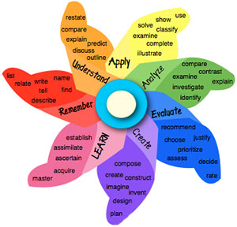
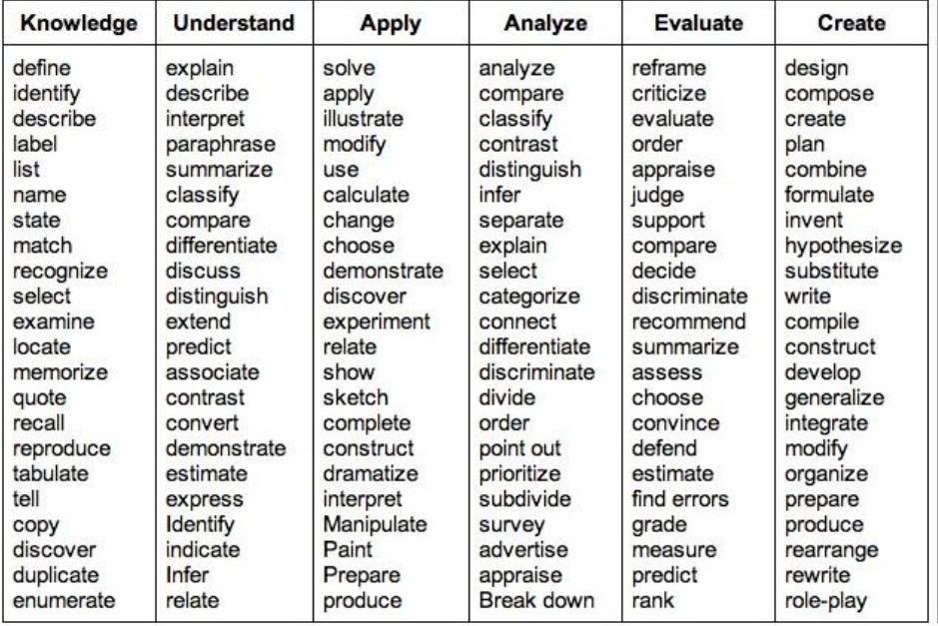
Service Learning & Bloom’s Taxonomy

Slide 18

8-Block design (Carleton College)
Service Learning 8-Block

Slide 19
Step Two:
Planning Course Instruction & Activities
Ted-Ed
https://ed.ted.com/educator
PBS Education
https://www.pbs.org/education/
YouTubeEDU
https://www.youtube.com/education
My Playlist
Facing History
https://www.facinghistory.org/educator-resources
Teaching Tolerance
https://www.tolerance.org/classroom-resources/lessons
Social Justice Books
https://socialjusticebooks.org/booklists/

Slide 20

Campus Compact
Syllabi Archive

Slide 21

Importance of REFLECTION

Slide 22


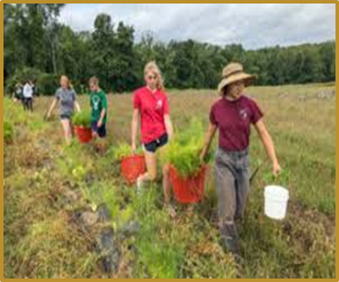
Step Three:
Articulating Expectations

Slide 23
Communication
Learn all you can about the organization first. Scour social media, their website, etc.
Start early (spring semester – early October; fall semester – June); send draft of syllabus with first correspondence
Email is fine to get started and communicate your interest and intent. But there’s no substitute for face-to-face meetings. Be sure to hold some of them at the community site. It is also a mistake to primarily communicate through email and on the phone. Those should be secondary to meeting in person.
You will also realize that college faculty members and those in a community organization live in two different worlds. That means you’ll need to work with the partner to find a common language (Canvas, midterms…)

Slide 24
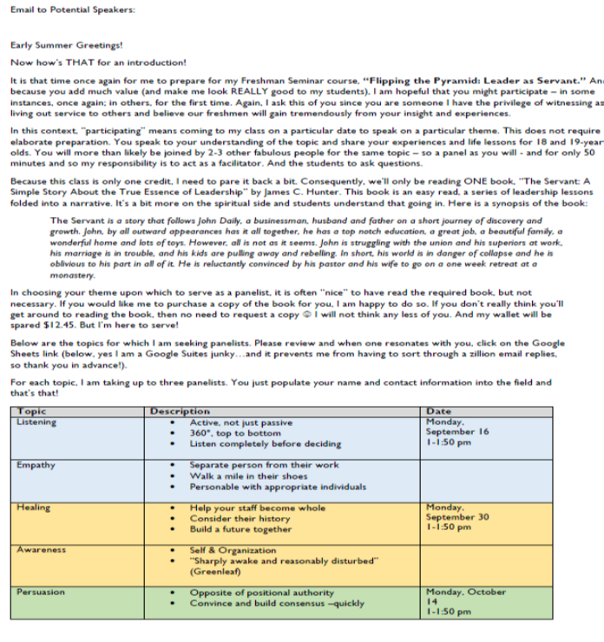


Slide 26
Commitment
The reality is that most community organizations operate on a shoestring budget with few staff. Often, the organization will base its ability to deliver services on the commitment you will give. They will make resource and service delivery choices based on your commitment of students’ time and energy.
Remember that the length of commitment is critical. Many community organizations will ask right away about the length and breadth of faculty commitment. The stronger the commitment to the organization, the more meaningful the service-learning experience will be for your students. The shorter the time the faculty member is committed to the project, the less useful it is to the organization.
Unless a short-term service project is 10 to 20 hours during a semester, and very carefully designed around specific community needs, it will be a net loss for the organization. There are times where a short-term project just is not worth the outlay of staff time, energy, and other resources the organization would be required to provide.
Faculty members should not expect the organization to provide too much to students in a short-term service-learning experience unless a project plan has been carefully worked out beforehand.

Slide 29
Compatibility
Compatibility should exist on several levels — such as the learning outcomes you want your students to achieve, and the tasks the community organization needs. There also needs to be compatibility with schedules and the number of hours, and the level of student preparation required related to the nature of the work.
For example, if the organization needs students to conduct group counseling with victims of domestic violence, the students would need to possess advanced counseling or social work skills.
The compatibility factor also reinforces the idea that service-learning is not just about students, but also about the needs of the community organization.

Slide 31
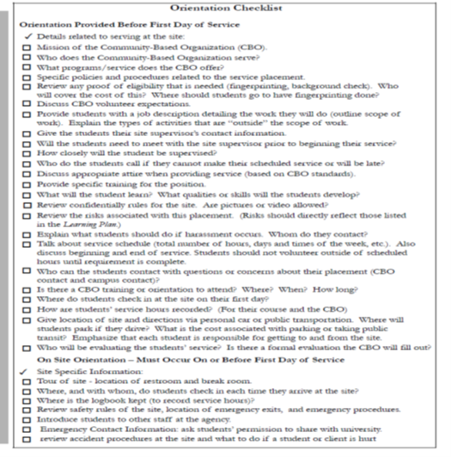
Prepare students: This might sound like it is stating the obvious, but it is very important. Students need to be fully prepared before they visit the community site, and then at the site. It is critical to talk with your community partner about what they would like students to know before service starts, and what you as a faculty member and they will provide. Avoid having any critical piece of information fall through the cracks.
Orientation and training should cover
• desired outcomes;
• issue information;
• the community;
• the agency;
• the population;
• a detailed list of tasks student will perform; and
• participants’ expectations and assumptions.
Prepared by: Community Campus Partnerships for Health. Faculty Toolkit for Service-Learning in Higher Education. Scotts Valley, CA: National Service Learning Clearinghouse

Slide 32

Wrap Up: Final To-do List…
DO thoroughly review the Service-Learning Agreement to understand the roles and responsibilities of all parties. DO ensure that service learners comply with any legal requirements for background checks.
DO assign a supervisor for service learners at your site.
DO orient all service learners to your organization and its policies, procedures, clientele profile, and emergency procedures. This will ensure that service learners act in safe, positive, and productive ways during their placements.
DO require that service learners complete a sign-in/out sheet each time they serve, so that you are aware of who is at your organization at all times.
DO communicate with university representatives if your organization is experiencing a difficult time with a service learner.
DO ensure that you have contact information for a representative at the university, in case problems arise, or accidents happen.
DON’T share the results of any background check with university representatives.
DON’T assume that any final products produced by students are the sole property of the community-based organization. The final products are the property of the student, but more often than not, the student can grant rights to use the product to the community-based organization.
DON’T request that service learners do tasks that are beyond their capabilities as volunteers, or beyond their scope of work, as outlined in the Service-Learning Agreement.

Slide 33

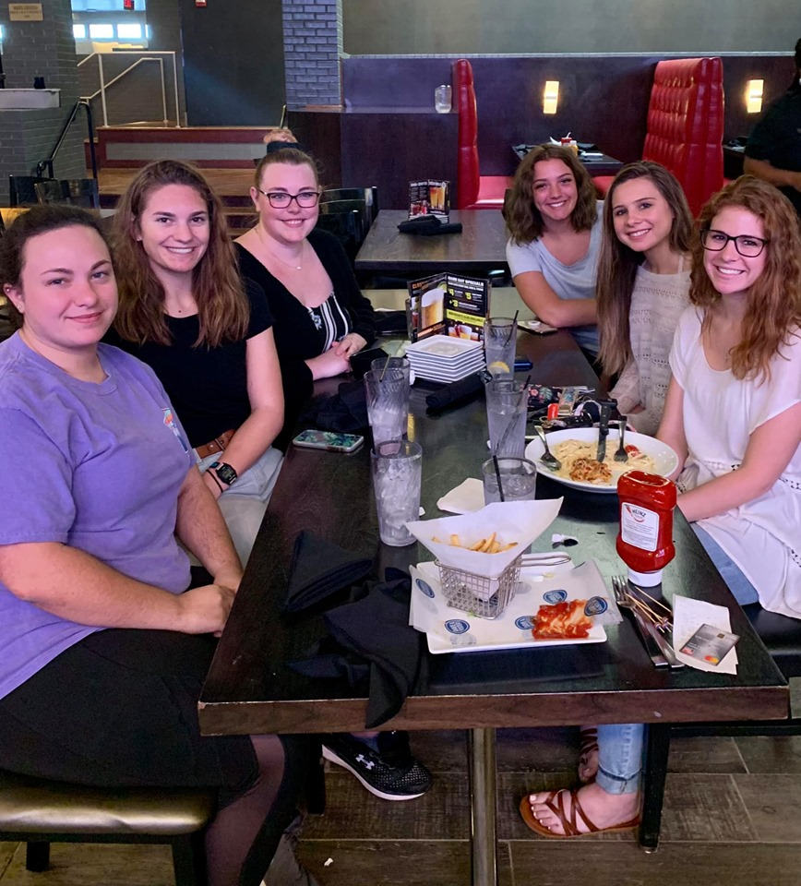
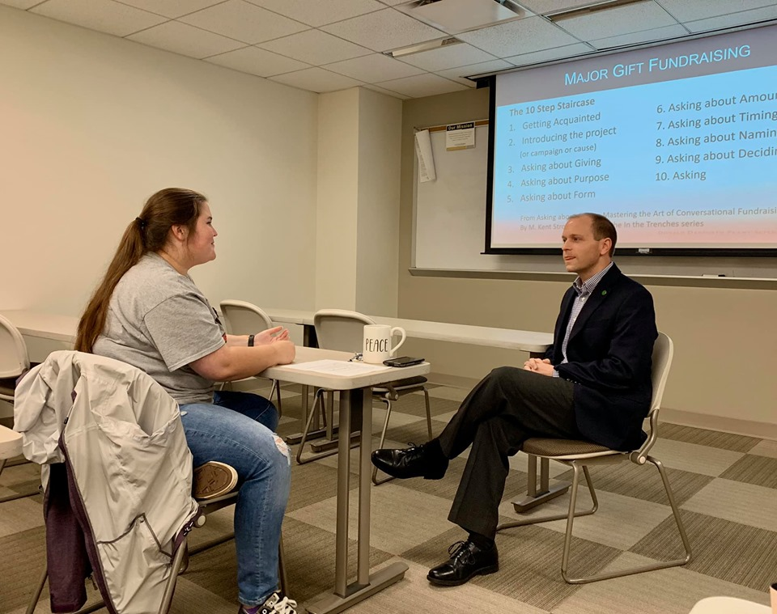
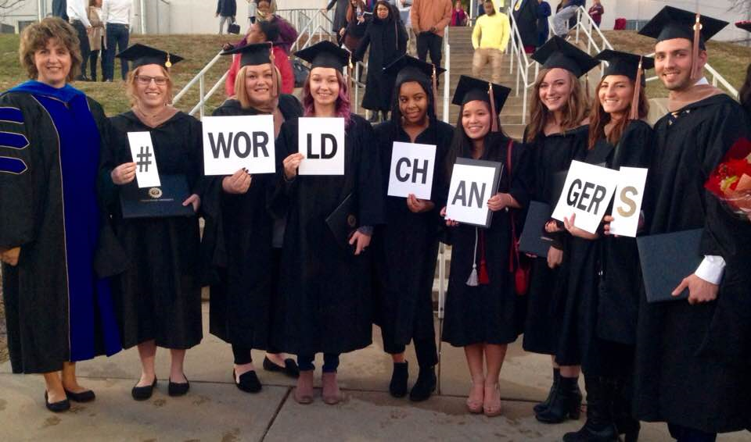
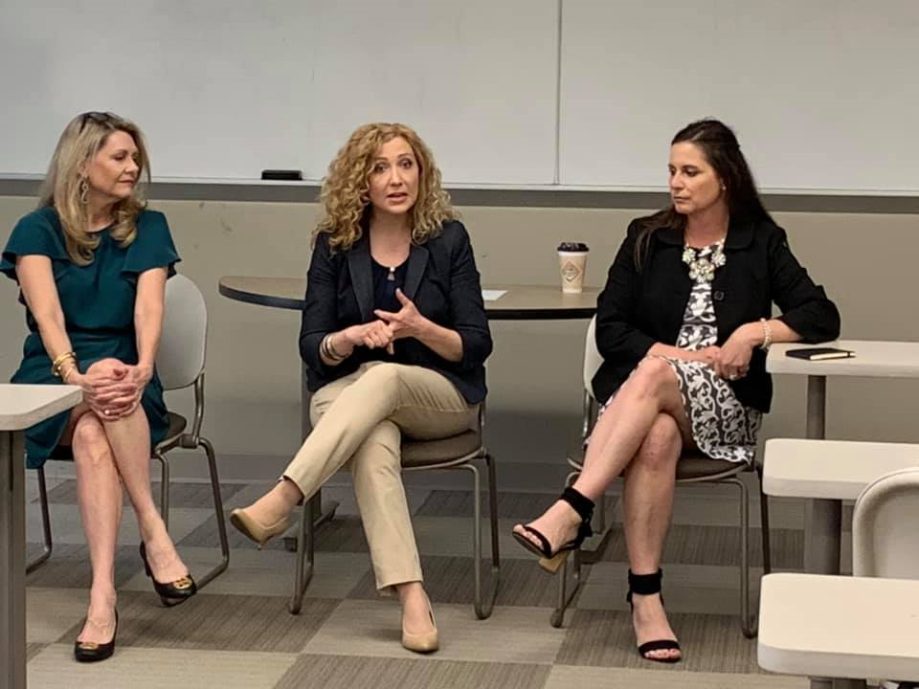
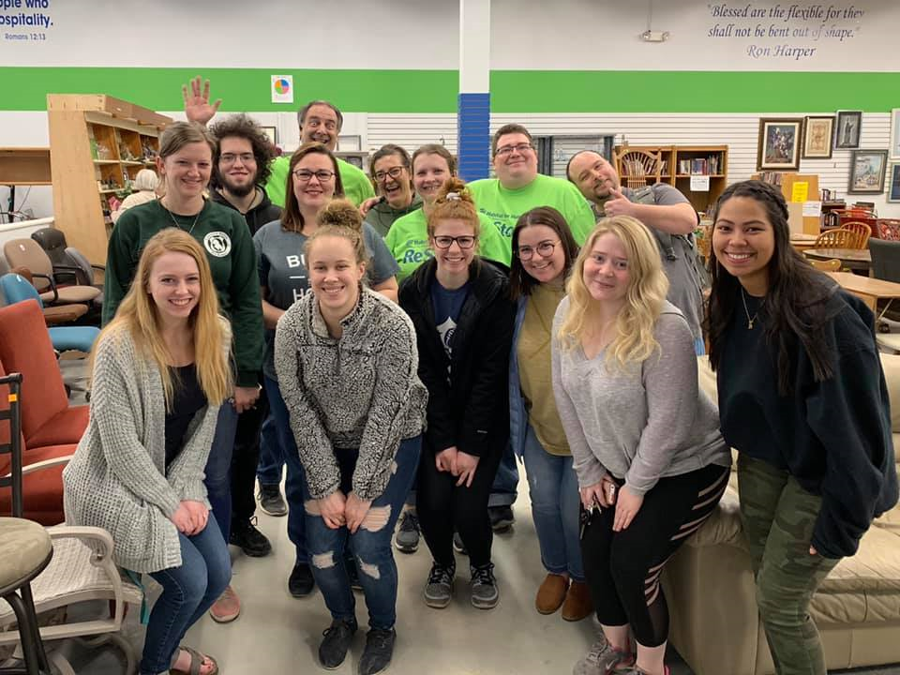

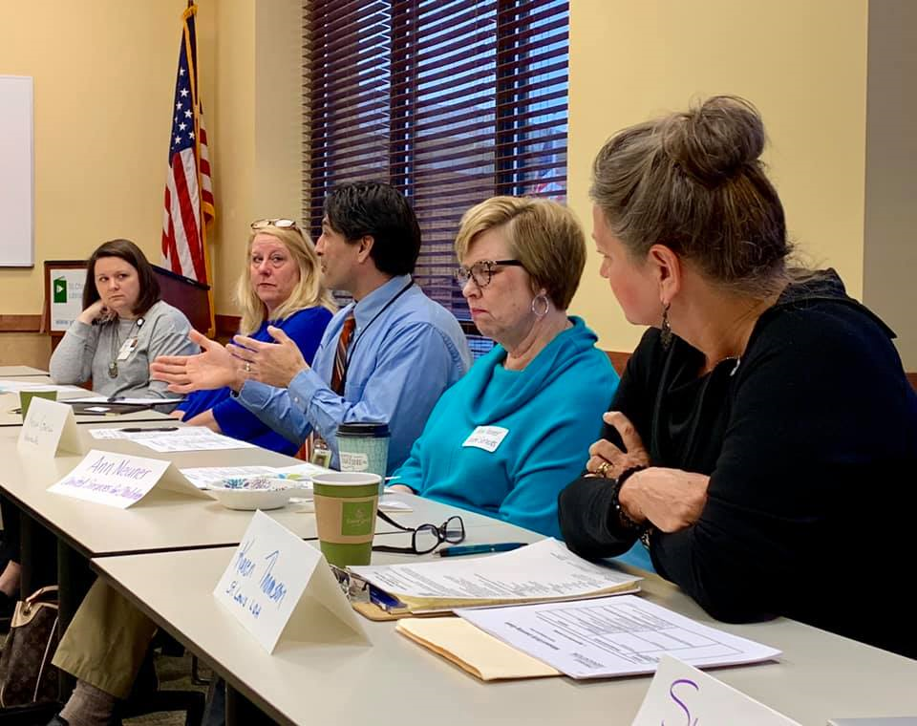
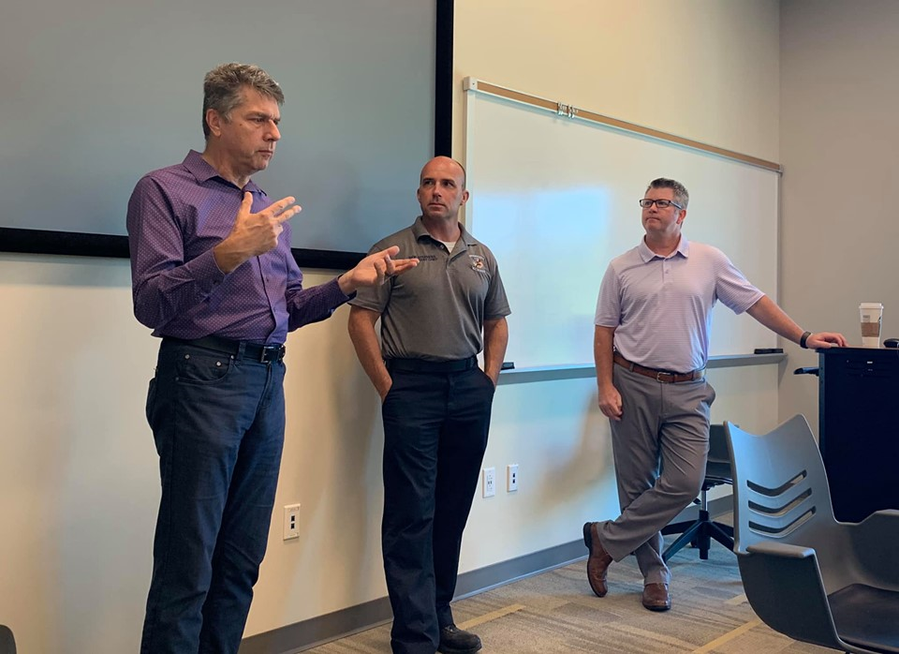
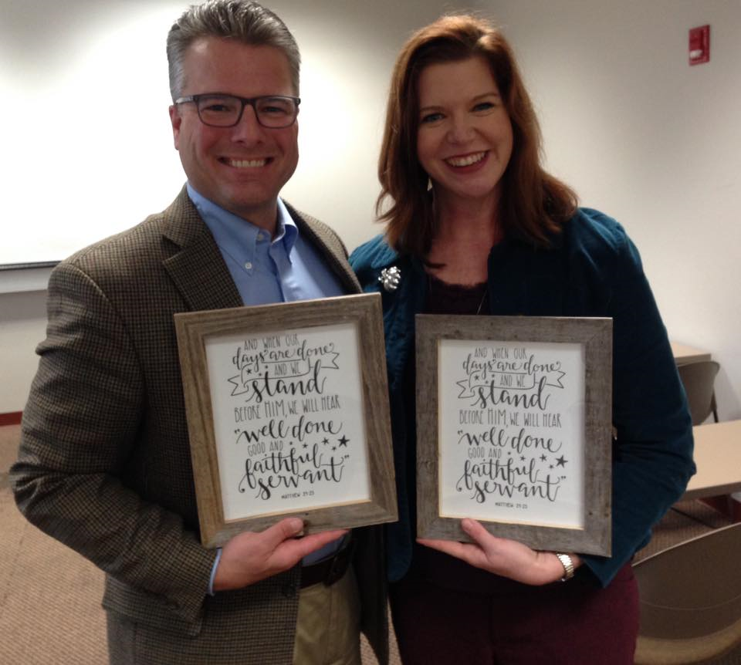
Celebrate Success!!

Slide 34
References
Center for Community Engagement, California State University-Long Beach. Service Learning Curriculum Guide.
Coles, R. (1993). The Call to Service: A Witness to Idealism. New York: Houghton Mifflin. Dewey, J. (1916). Democracy and Education. New York: The Free Press.
Dewey, J. (1933). How We Think. Boston: Heath. Hatcher, J. & Bringle, R. (1997).
Reflection: Bridging the Gap between Service and Learning.‖ In College Teaching, Volume 45, Number 4. Kolb, D. A. (1984). Experiential Learning: Experience as the Source of Learning and Development. Englewood Cliffs, N.J: Prentice-Hall. Lisman, D. C. (1994:3).
Ethics and Service Learning. Communique 6:3 Meza, Ariz: Campus Compact for Community Colleges.
Kolb, A. Y., & Kolb, D. A. (2005). Learning Styles and Learning Spaces: Enhancing Experiential Learning in Higher Education. Academy of Management Learning & Education, 4, 193-212.
National Survey of Student Engagement (2007). Experiences that matter: Enhancing student learning and success—Annual Report 2007. Bloomington, IN: Indiana University Center for Postsecondary Research. http://nsse.indiana.edu/html/about.cfm
Seifer SD and Connors K. , Eds. Community Campus Partnerships for Health. Faculty Toolkit for Service-Learning in Higher Education. Scotts Valley, CA: National ServiceLearning Clearinghouse, 2007.
Service-learning workshop materials developed by the Center for Community Service-Learning at CSU-Northridge.
Steinke. S. and Buresh, P. (2002). Cognitive outcomes of service learning: Reviewing the past and glimpsing the future. Michigan Journal of Community Service Learning. Vol. 8. http://hdl.handle.net/2027/spo.3239521.0008.201

Slide 35
Presenter Contact Information
Dr. Julie Turner
jturner@lindenwood.edu

