Slide 1
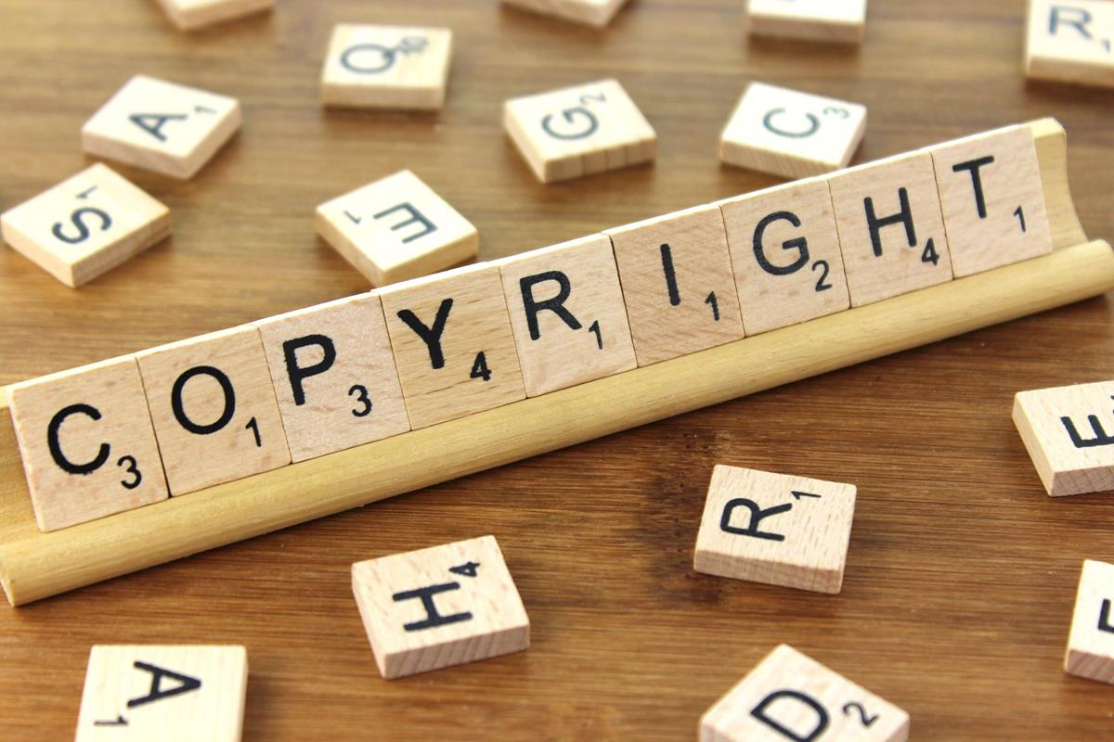
What Does Copyright Mean
for Online Teachers and Students Today?
This Photo by Unknown Author is licensed under CC BY-SA
11 AM Monday, Feb. 7
Transforming the Teaching & Learning Environment
The 2022 Virtual Conference
February 7-18, 2022
Linda J. Smith, Ph.D.

Slide 2
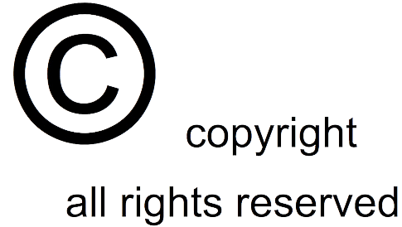
Copyright Topics
The need to understand copyright details today
Some copyright basics
The usage restrictions spectrum
Knowledge checks
Defining “fair use”
Protecting your intellectual property
This Photo by Unknown Author is licensed under CC BY-NC

Slide 3
The Impact of the Internet on Copyright
Access to intellectual property and opportunities for infringement today are much broader compared to prior technologies (e.g., photocopies and recordings).
This Photo by Unknown Author is licensed under CC BY
New technologies and expanded access possibilities bring both new benefits and new concerns.

Slide 4
Some Copyright Basics
Highlights:
As of January 1, 1978, a copyright generally endures for the life of the author and 70 years after the author’s death.
Copyrights may be renewed and transferred.
“Copies” are material objects in which a work is “fixed.”
A work is “created” and protected when it is fixed in a copy for the first time; if created over time or in different versions, each version is a separate work.
Examples of works include: literary works; musical works; graphic works; audiovisual works; sound recordings; and others.
“Exclusive rights” may not extend to certain copies, such as for backup.
Registration with the U.S. Copyright Office is not required for protection, but it offers advantages in litigation.
“Fair use” is determined by guidelines rather than specific definition.
This Photo by Unknown Author is licensed under CC BY-SA

Slide 5
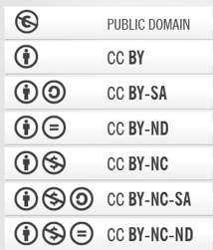
A Usage Restrictions Spectrum
Public Domain
Open use
Least
Restricted
Creative Commons Licenses
Open use with possible limitations
Most
Restricted
Permissions required and may vary by source—check “fair use” guidelines
All Rights Reserved
This Photo by Unknown Author is licensed under CC BY-SA

Slide 6
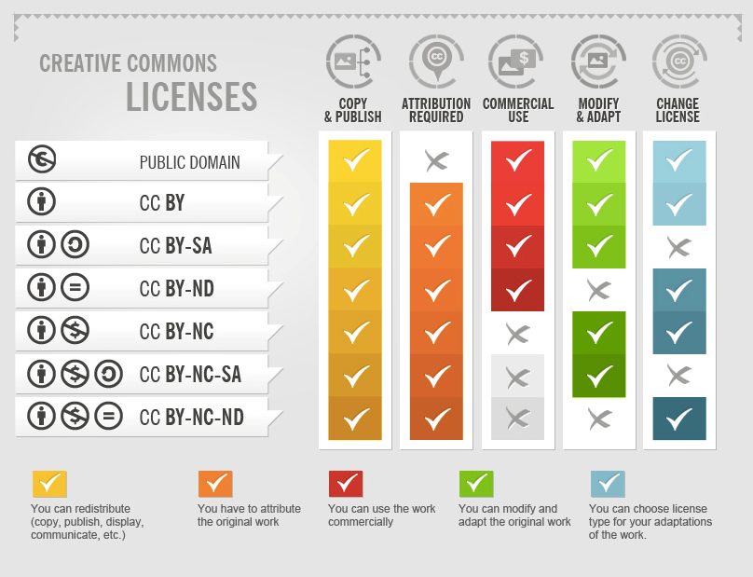
CREATIVE COMMONS
This Photo by Unknown Author is licensed under CC BY

Slide 7
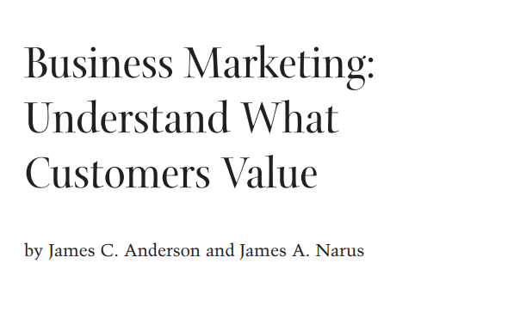
Knowledge Check
If I found it online, I can copy and use it—right?
A PDF for this Harvard Business Review article is accessible through a Google Scholar search. Is it acceptable to download it for use in your class?

Slide 8
Knowledge Check - Answer
No. A review of the file indicates that the HBR granted use of this article for a specific time period in a marketing course. Articles in journals are usually available only to subscribers and those willing to pay for individual copy downloads. Should the professors have stored it in a site open to anyone with Internet access?

Slide 9
Knowledge Check
Your university library subscribes to the Harvard Business Review. Can you use its articles as required readings in your course?

Slide 10
Knowledge Check - Answer
Not without specific permission of HBR. Harvard Business Publishing will work with educators, but their business model includes a cost-per-student requirement when using their materials.
Magazine, journal and other material sources may depend on income from subscriptions. Some publishers restrict use to ensure sufficient income for their operations.

Slide 11
Knowledge Check
Are these two images presented correctly according to copyright requirements?
1
2
This Photo by Unknown Author is licensed under CC BY-NC-SA
This Photo by Unknown Author is licensed under CC BY-NC

Slide 12
Knowledge Check - Answer
No. Image 1 is presented correctly if it is being viewed in an environment in which the hyperlinks are active. Image 2 is not presented correctly because the hyperlinks are not active. In this case, the attribution information should be specifically included with the image. Do we need to think about how images are reproduced when including the Creative Commons information?
1
2
This Photo by Unknown Author is licensed under CC BY-NC
This Photo by Unknown Author is licensed under CC BY-NC-SA

Slide 13
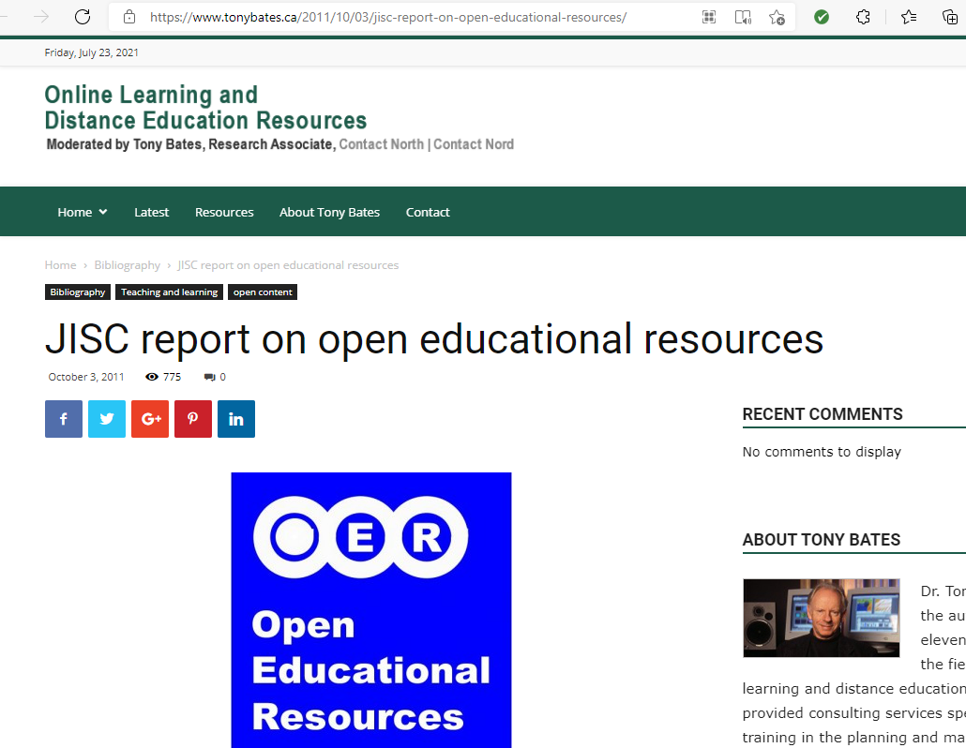
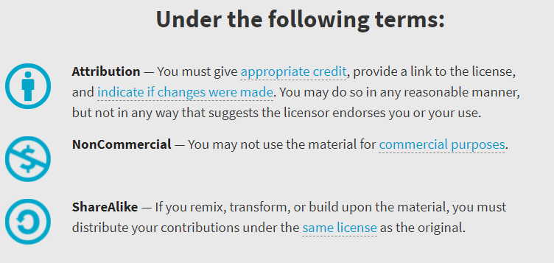
Knowledge Check – Answer Continued
This Photo by Unknown Author is licensed under CC BY-NC-SA

Slide 14
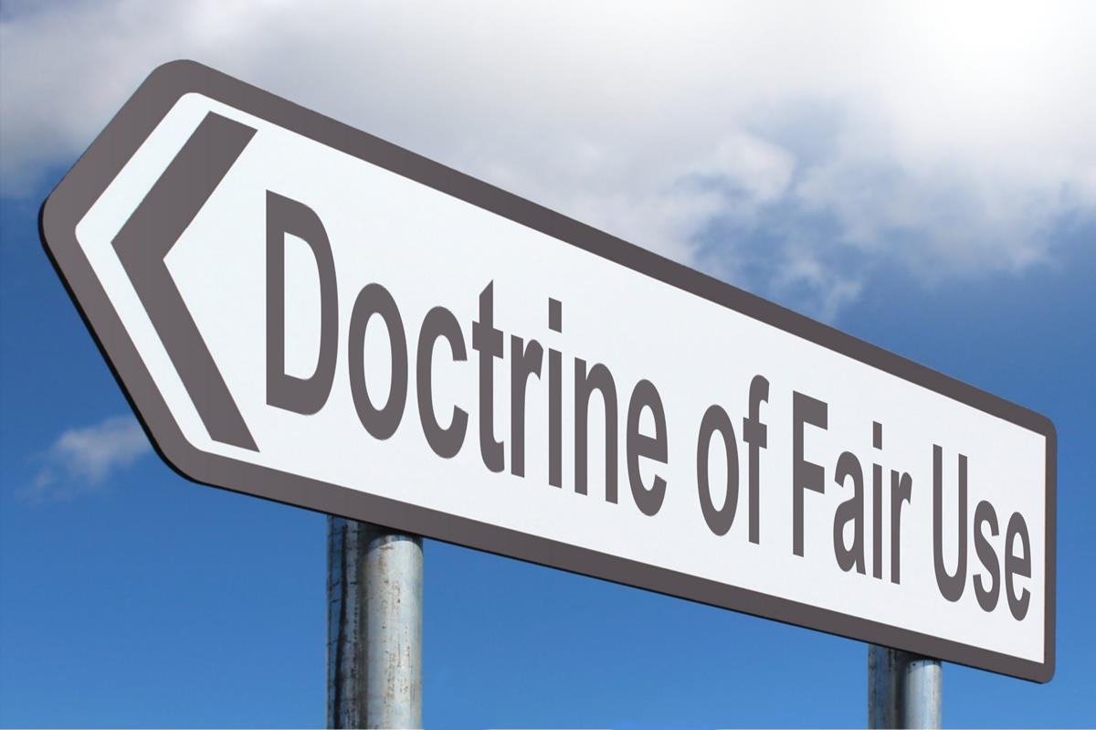
Knowledge Check
True or false: You may use a copyrighted item if it is for educational purposes under “Fair Use.”
This Photo by Unknown Author is licensed under CC BY-SA

Slide 15
Knowledge Check - Answer
The definition of “Fair Use” is based on a set of considerations rather than a specific rule. Which of the following might take precedence today for online learning?
107. Limitations on exclusive rights: Fair use⁴¹
Notwithstanding the provisions of sections 106 and 106A, the fair use of a copyrighted work, including such use by reproduction in copies or phonorecords or by any other means specified by that section, for purposes such as criticism, comment, news reporting, teaching (including multiple copies for classroom use), scholarship, or research, is not an infringement of copyright. In determining whether the use made of a work in any particular case is a fair use the factors to be considered shall include—
(1) the purpose and character of the use, including whether such use is of a commercial nature or is for nonprofit educational purposes;
(2) the nature of the copyrighted work;
(3) the amount and substantiality of the portion used in relation to the copyrighted work as a whole; and
(4) the effect of the use upon the potential market for or value of the copyrighted work.
The fact that a work is unpublished shall not itself bar a finding of fair use if such finding is made upon consideration of all the above factors.

Slide 16
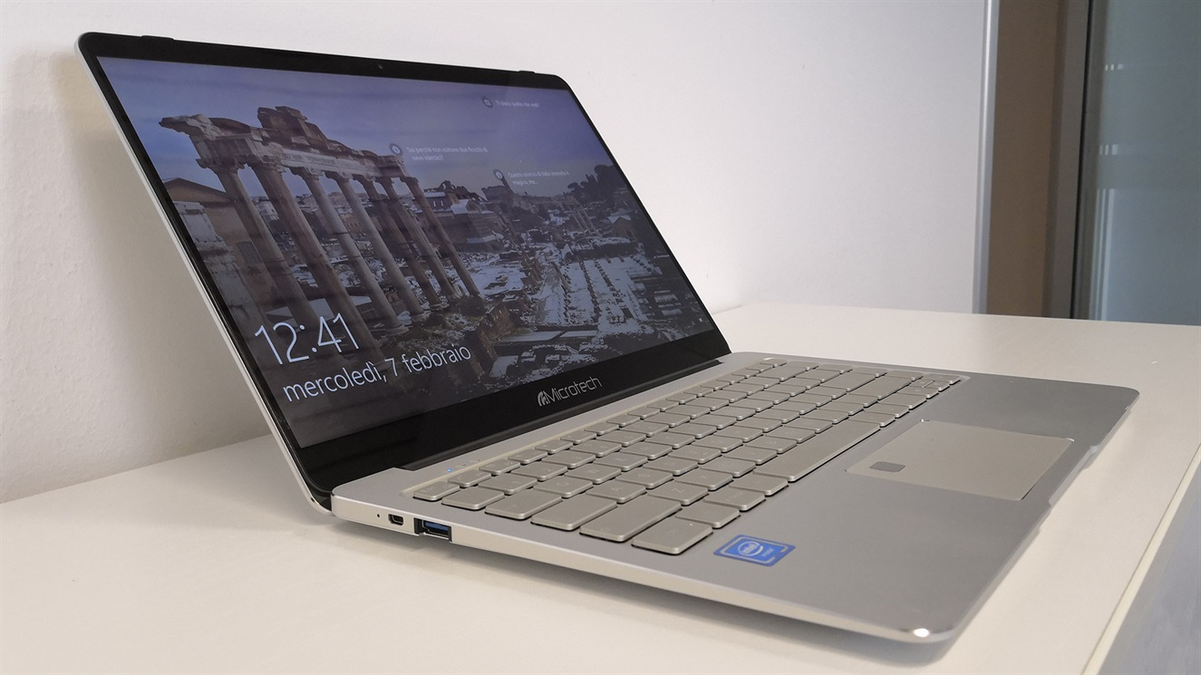
Knowledge Check
True or False: If your university library has a digital copy of a book, you may assign it as a textbook in your online course.
This Photo by Unknown Author is licensed under CC BY-NC-ND

Slide 17
Knowledge Check - Answer
Probably not. You must check the permissions information in any book you want to assign for reading in your course. Digital copies are similar to printed books regarding the number of copies that are available on the digital shelf. There may be restrictions on the number of concurrent users and how many users may access the book in a given time period.
This Photo by Unknown Author is licensed under CC BY-SA

Slide 18
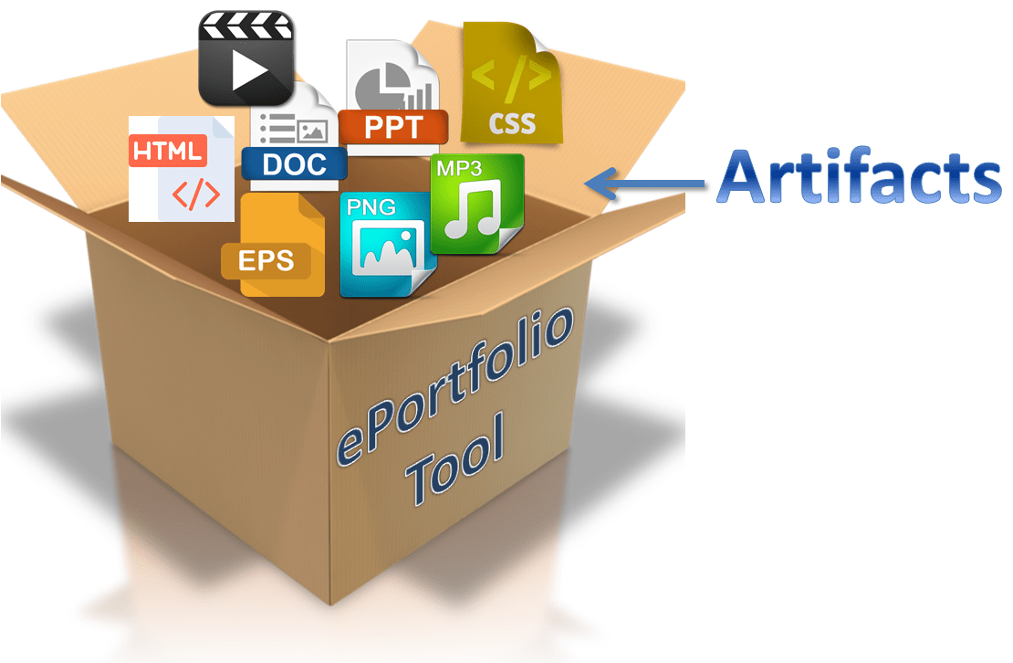
Knowledge Check
True or false: Free services, such as e-portfolio sites, will store my content safely and not allow it to be distributed in ways not aligned with my primary purpose for using the site.
This Photo by Unknown Author is licensed under CC BY-SA-NC

Slide 19
Knowledge Check - Answer
Maybe not! Read the fine print. Is “free” really a safe choice?
7. Your rights in your Content
Weebly does not claim ownership of your Content (as defined below), but you give us your permission worldwide to host your Content on the Service and to perform all acts necessary to host your Content on the Service (such as making copies, reformatting, and distributing your Content). In other words, you grant us and our subsidiaries affiliates, and successors a worldwide, non-exclusive, royalty-free, fully-paid, transferable, irrevocable, perpetual, and sub-licensable right to use, reproduce, modify, adapt, publish, prepare derivative works of, distribute, publicly perform, and publicly display your Content throughout the world in any media.
We do not want to receive confidential or proprietary information from you through the Service or by email. Unless otherwise agreed in writing by an authorized Weebly representative, any material, information or idea you transmit to us by any means may be disseminated or used by us or our affiliates without compensation or liability to you for any purpose whatsoever, including, but not limited to, developing, manufacturing and marketing products. However, this provision does not apply to Content or to personal information that is subject to our Privacy Notice.
https://www.weebly.com/terms-of-service

Slide 20
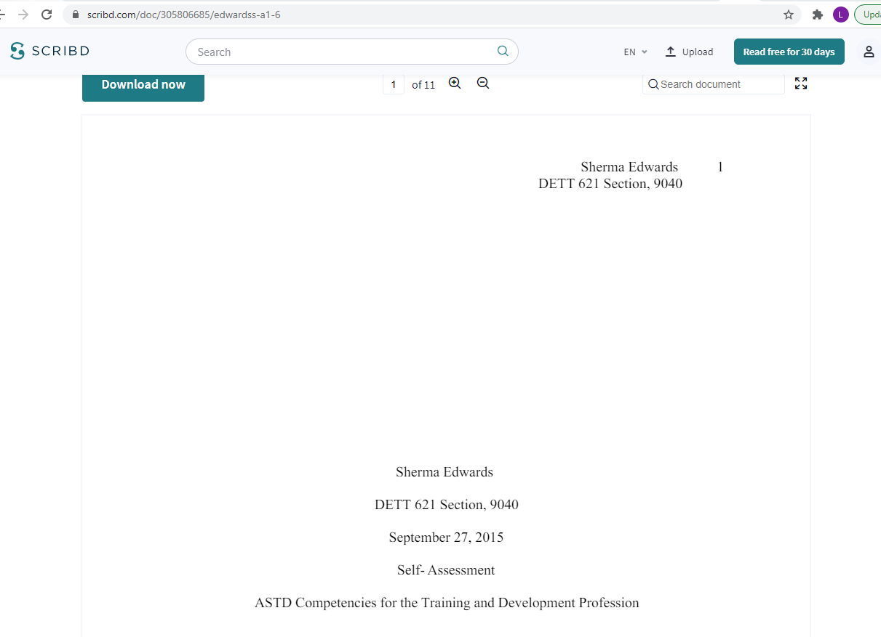
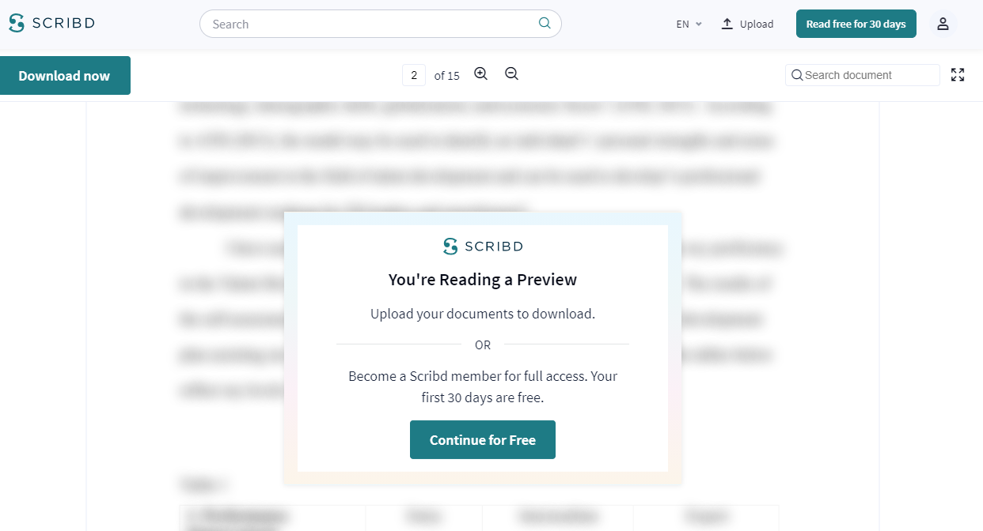
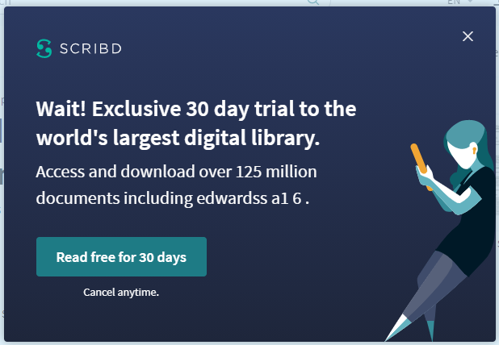
Example of “Free” Site Use of Author’s Work
Student “example” papers were found for virtually every course in a graduate master’s program. They were also discovered to be the source of plagiarism.

Slide 21
Knowledge Check
I came up with an idea for a new procedure for creating online courses, and I created a course to teach it to instructional design students. I just found that someone else is teaching the same kind of course at another university. Can I sue that university for copyright infringement?”
This Photo by Unknown Author is licensed under CC BY-SA

Slide 22
Knowledge Check - Answer
No. According to Copyright Law (section 102.b), “In no case does copyright protection for an original work of authorship extend to any idea, procedure, process, system, method of operation, concept, principle, or discovery, regardless of the form in which it is described, explained, illustrated, or embodied in such work.”
However, a work in which an idea, procedure, etc. is described or represented may be protected. In other words, someone can use the same idea, but they may not copy your expression of it without your permission.

Slide 23
Recommendations for Copyright Safety
Avoiding
infringement
Do not assume “accessible” means “permission granted.”
Check copyright statements for all materials used in your online courses.
Ensure Creative Commons restrictions and license requirements are followed.
When in doubt about “fair use,” define usage plans and request permission from copyright owner.
Protecting your work
“Sign” and date your work.
Be specific about any copyright restrictions you want associated with all versions of your work.
Read the details regarding permissions for your work when entering into a relationship with any service, free or paid.
Consider registering your work with the U.S. Copyright Office.

Slide 24
Copyright References
OER
Repurpose
This Photo by Unknown Author is licensed under CC BY-NC-SA
This Photo by Unknown Author is licensed under CC BY-NC-SA
COPYRIGHT LAW
U.S. Copyright Office. https://copyright.gov
CREATIVE COMMONS LICENSE INFORMATION
Creative Commons. http://creativecommons.org
ARTICLE EXPLAINING COPYRIGHT AND FAIR USE
Harvard University, Office of the General Counsel
Copyright and Fair Use
https://ogc.harvard.edu/pages/copyright-and-fair-use

Slide 25
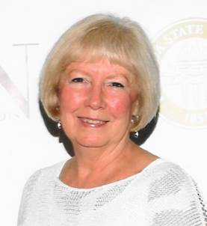
ADDITIONAL QUESTIONS?
Linda J Smith, Ph.D.
Distance Learning Consultant and Adjunct Faculty
Ljsmith7@hotmail.com
Linkedin.com/in/linda-j-smith
Blog: linda-online.net
Twitter: @EDU_LJS

